Slide 1

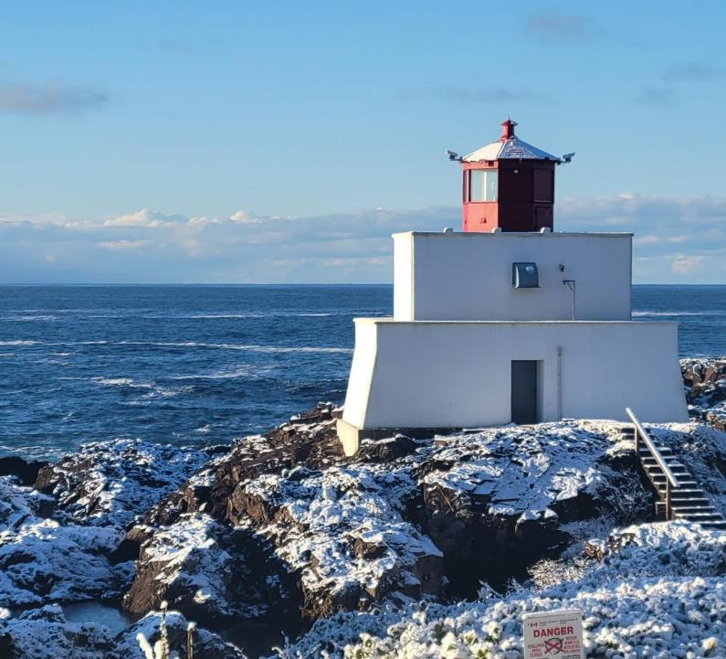
2024 – 2028 Budget

Slide 2
Budget cycle 2024
Pre-Budget Workshop
November 28/23
Presentation of Draft Budget
January 8/24
Revised Budget
February 20/24
Official Public Engagement Period
February 26 - March 29
Council Receives Feedback & Budget with Updated Role Directs Staff to Prepare Bylaws
April 11/24
Adoption of 5 Year Financial Plan & Tax Rates Bylaws
May 14/24
Staff Update of Operational and Capital Budgets
Sept - Nov
Budget Update
(If Required)
January 30/24

Slide 3
Department overviews
Department overviews will provide a summary of:
  2023 approved budget
  Any revenues attributed to the department
  Anticipated 5-year spending
  Summary of any significant changes within the department
  Generally, staff have used a 2% – 4% inflation model to forecast 2025 – 2028 budgets
  2024 budget adjustments are based on 2023 expenditures and revenues
  Budget numbers are accurate up to December 1, 2023. Final adjustments for revenues and expenditures can not be made until mid January after year end has been completed.
NOTE: Revenues are shown as negative values in red. Expenditures and shown in black.

Slide 4
ADMINISTRATION
 | 2024 | 2025 | 2026 | 2027 | 2028
Other Fees & Cost Recovery | -$58,344 | -$59,111 | -$59,893 | -$60,691 | -$61,505
Payments In Lieu of Taxes | -$96,851 | -$96,851 | -$96,851 | -$96,851 | -$96,851
Annual Grants | -$352,000 | -$352,000 | -$352,000 | -$352,000 | -$352,000
Interest | -$116,040 | -$118,361 | -$120,728 | -$123,143 | -$125,605
Municipal Office | $16,526 | $16,857 | $17,194 | $17,538 | $17,889
Administration | $1,143,092 | $1,182,059 | $1,166,171 | $1,206,574 | $1,222,141
Information Technology | $119,617 | $122,009 | $124,450 | $126,939 | $129,477
Legal & Audit Services | $132,000 | $134,640 | $137,333 | $140,079 | $142,881
Insurance | $134,038 | $136,718 | $139,453 | $142,242 | $145,087
Fiscal Services (Debt) | $235,258 | $219,671 | $193,688 | $196,110 | $119,869
Total Expenses | $1,780,531 | $1,811,955 | $1,778,288 | $1,829,482 | $1,777,344
IT Software | Corporate | 10,000 | Increased software licencing fees
Legal | Corporate | 55,000 | Increased legal fees
HR Recruitment & Expenses | Corporate | -25,000 | Moved rental housing to a separate gl
Admin Salaries and Benefits | Finance | 120,000 | Addition of a new Executive Assistant (wages and benefits)
Tourism Ucluelet (MRDT) | Finance | -384,000 | Transferred to TU; TU holds in trust OAP for affordable housing
Staff housing | Finance | 46,000 | Separated out from HR & Recruitment; two dwellings; rental fees are cost recovered
Insurance | Finance | 25,000 | Increase in insurance fees and charges
Fiscal Services (Debt) | Finance | 311,592 | Paydown of debt contemplated in 2023 that did not occur
Notes:
LEGAL FEES – were over budget in 2023 due to ongoing Onni Legal challenges, anticipate those to reduce back down to normal in 2024
Insurance rates increases were 10.6% for 2024

Slide 5
Council
 | 2024 | 2025 | 2026 | 2027 | 2028
Mayor & Council | $158,284 | $163,033 | $167,108 | $171,286 | $175,568
Council Conferences | $45,750 | $46,665 | $47,598 | $48,550 | $49,521
Grants & In-kind Contributions | $114,250 | $80,200 | $71,169 | $72,157 | $73,166
Council Promotion | $20,000 | $20,400 | $20,808 | $21,224 | $21,649
Total Expenses | $338,284 | $310,298 | $306,684 | $313,218 | $319,904
Grants In Aid | Finance | 35,000 | Addition of $35,000 for Chamber of Commerce request
Notes:
Council Promotion - $5K for Mayor Radio Spots; recognition actives
In Kind (lease donations, grants in aid)

Slide 6
Planning & development
 | 2024 | 2025 | 2026 | 2027 | 2028
Business Licences | -$210,060 | -$214,262 | -$218,547 | -$222,918 | -$227,376
Permits | -$151,046 | -$154,067 | -$157,148 | -$160,291 | -$163,497
Planning Administration | $494,298 | $504,184 | $514,267 | $524,553 | $535,044
Planning Legal & Consultants | $78,514 | $79,284 | $80,070 | $80,871 | $81,689
Bylaw | $137,338 | $140,085 | $142,886 | $145,744 | $148,659
Building Inspection | $138,856 | $141,633 | $144,466 | $147,355 | $150,302
Total Expenses | $849,006 | $865,186 | $881,689 | $898,523 | $915,694
Building Inspection Contractor | Planning | -14,000 | Planned reduction in use of supporting building inspector from Tofino
Planning Consultants | Planning | 20,000 | Increased consultant costs for updating planning documents
Planning Salaries and Benefits | Planning | 130,000 | Addition of a new planner Funded through $160K from ministry of housing
Notes:
$160K Housing Capacity Funding – Ministry of Housing
BL projected to be down slightly – indications of softening of BL renewals
BL- fuel, insurance, training, S&M, IT, wages

Slide 7
Emergency Services & Management
 | 2024 | 2025 | 2026 | 2027 | 2028
Protective Service Agreements | -$63,045 | -$63,625 | -$64,217 | -$64,820 | -$65,436
Administration | $247,455 | $259,667 | $264,860 | $270,158 | $275,561
Training & Retention | $86,560 | $88,081 | $89,633 | $91,215 | $92,830
General Operations | $154,981 | $158,081 | $161,242 | $164,467 | $167,756
Emergency Services | $19,925 | $20,324 | $20,730 | $21,145 | $21,567
Total Expenses | $508,921 | $526,152 | $536,465 | $546,985 | $557,714
Fire Salaries and Benefits | Fire | 46,000 | Funding of remaining six-months for Deputy Fire Chief position (wages and benefits)
Notes:
Supplies and materials, training, travel, comms, equipment repairs, maintenance, insurance, inspections
Training, supplies, equipment, EOC, IT

Slide 8
recreation
 | 2024 | 2025 | 2026 | 2027 | 2028
Recreation Fees | -$577,649 | -$595,967 | -$605,472 | -$615,166 | -$625,055
Administration | $667,870 | $681,017 | $694,428 | $708,106 | $722,058
Programs | $203,989 | $208,069 | $212,230 | $216,475 | $220,804
Events | $128,466 | $131,035 | $133,656 | $136,329 | $139,056
Recreation Buildings | $159,010 | $149,960 | $152,960 | $156,019 | $159,139
Equipment | $9,178 | $9,362 | $9,549 | $9,740 | $9,935
Lighthouse | $28,600 | $29,172 | $29,755 | $30,351 | $30,958
Total Expenses | $1,197,113 | $1,208,616 | $1,232,578 | $1,257,019 | $1,281,950
Lighthouse | Recreation | 28,000 | Operational costs for lighthouse residence, cost recovered
Janitorial Supplies | Recreation | 7,000 | Replacement of an old floor machine at the UCC
Recreation Programs | Recreation | 40,000 | Increased supplies, materials and instructor costs for increased programming; Cost recovered
Special Events Contractor | Recreation | 20,000 | Funding of contractor through RMI and Ukee days; Focus on increasing number of community activities and events

Slide 9
operations
 | 2024 | 2025 | 2026 | 2027 | 2028
Cemetery | -$4,000 | -$4,080 | -$4,162 | -$4,245 | -$4,330
Parking | -$200,000 | -$204,000 | -$208,080 | -$212,242 | -$216,486
Administration | $221,056 | $225,477 | $229,987 | $234,587 | $239,278
General Operations | $194,034 | $186,195 | $189,918 | $193,717 | $197,591
Parking Program | $200,000 | $204,000 | $208,080 | $212,242 | $216,486
Equipment | $132,421 | $135,070 | $137,771 | $140,526 | $143,337
Roads & Sidewalks | $205,327 | $209,434 | $213,622 | $217,895 | $222,253
Storm System | $35,938 | $36,657 | $37,390 | $38,138 | $38,901
Cemetery | $22,275 | $22,720 | $23,174 | $23,638 | $24,111
Parks Administration | $122,690 | $125,144 | $127,646 | $130,199 | $132,803
Parks Equipment | $86,669 | $88,402 | $90,170 | $91,974 | $93,813
Parks General Operations | $569,755 | $581,150 | $592,773 | $604,629 | $616,721
Total Expenses | $1,790,165 | $1,814,248 | $1,850,533 | $1,887,543 | $1,925,294
Operations Training | Operations | 10,000 | Increased training budget to meet operations certification and training requirements
Operations Small Tools & Equipment | Operations | 10,000 | Tool replacement
Cemetery Supplies and Materials | Parks | 4,000 | Increased liner costs for burials
Parking Program | Operations | 200,000 | $200,000 revenue and expense for potential implementation of parking program
Notes:
Supplies and materials, employees, hydro, equipment, contracted services, insurance
Parks is not broken down, inclusive of all park areas (trails, sports fields, recreation grounds
Operations appear lower as time is allocated to sewer and water separately.

Slide 10
Summary of significant changes
IT Software | Corporate | $ 10,000 | Increased software licencing fees
Legal | Corporate | $ 55,000 | Increase in legal services
HR Recruitment & Expenses | Corporate | -$ 25,000 | Moved rental housing to a separate gl
Admin Salaries and Benefits | Finance | $ 120,000 | Addition of a new Executive Assistant (wages and benefits)
Tourism Ucluelet (MRDT) | Finance | -$ 384,000 | Transferred to TU; TU holds in trust OAP for affordable housing
Staff housing | Finance | $ 46,000 | Separated out from HR & Recruitment; two dwellings; rental fees are cost recovered
Insurance | Finance | $ 25,000 | Increase in insurance fees and charges
Grants In Aid | Finance | $ 35,000 | Addition of $35,000 for Chamber of Commerce request
Fire Salaries and Benefits | Fire | $ 46,000 | Deputy fire chief
Operations Training | Operations | $ 10,000 | Increased training budget for operations certifications and training
Operations Small Tools & Equipment | Operations | $ 10,000 | Tool replacement
Cemetery Supplies and Materials | Parks | $ 4,000 | Increased liner costs for burials
Building Inspection Contractor | Planning | -$ 14,000 | Planned reduction in use of supporting building inspector from Tofino
Planning Consultants | Planning | $ 20,000 | Increased consultant costs for updating planning documents
Planning Salaries and Benefits | Planning | $ 130,000 | Addition of a new planner (wages and benefits) Funded through $160K from ministry of housing
Lighthouse | Recreation | $ 28,000 | Operational costs for lighthouse residence, cost recovered
Janitorial Supplies | Recreation | $ 7,000 | Replacement of an old floor machine for the UCC
Recreation Programs | Recreation | $ 40,000 | Increased supplies, materials and instructor costs for increased programming; cost recovered
Special Events Contractor | Recreation | $ 20,000 | Funding of contractor through RMI and Ukee days; Focus on increasing number of community activities and events
Parking Program | Operations | $ 200,000 | Place holder for parking program – $200k for both revenue and expenses resulting in no tax implications

Slide 11
Operation projects
Project | Fund | 2024 | 2025 | 2026 | 2027 | 2028
Website Rebuild | Grant | 47,745
Records Management | Grant |  | 50,000
Winter Lights | RMI | 29,159
Pathway & Heritage Signage (Wayfinding) | General | 80,000
Kitchen Fire Suppression Unit | RR | 40,000
RMI - First Nation collaboration Projects | RMI | 95,202
P&R Master Plan | RR | 60,000
DCC Bylaw Update | Grant | 120,000
Subdivision Servicing Bylaw Update | Grant | 50,000
WPT Society Annual Project Contribution | RMI | 10,000
Lighthouse Furnishings | RMI | 60,000
Total Expenses |  | 592,106 | 50,000
Notes:
DCC Bylaw Update – increase allocation to $120,000 to allow for amenity cost charge development, increased project cost verifications, allowance for a policy implementation manual and training. (100% grant funded)
Subdivision Servicing Bylaw – 100% grant funded
Parks and Rec Master Plan increased to $60K to reflect RFP results – 100% grant funded.
Heritage and pathway signage combi
UCC Exterior painting – deferred
First Nations Collaboration – included EMCR Grant into project
Increased by $10K

Slide 12
DRAFT
5-YR
Operations SUMMARY
 | 2024 | 2025 | 2026 | 2027 | 2028
Property Taxes | -$4,479,953 | -$4,519,100 | -$4,699,141 | -$4,820,405 | -$4,839,759
Payments In Lieu of Taxes | -$96,851 | -$96,851 | -$96,851 | -$96,851 | -$96,851
Business Licences | -$210,060 | -$214,262 | -$218,547 | -$222,918 | -$227,376
Permits | -$151,046 | -$154,067 | -$157,148 | -$160,291 | -$163,497
Protective Service Agreements | -$63,045 | -$63,625 | -$64,217 | -$64,820 | -$65,436
Recreation Fees | -$577,649 | -$595,967 | -$605,472 | -$615,166 | -$625,055
Annual Grants | -$352,000 | -$352,000 | -$352,000 | -$352,000 | -$352,000
Cemetery | -$4,000 | -$4,080 | -$4,162 | -$4,245 | -$4,330
Parking Program | -$200,000 | -$204,000 | -$208,080 | -$212,242 | -$216,486
Interest | -$116,040 | -$118,361 | -$120,728 | -$123,143 | -$125,605
Other Fees & Cost Recovery | -$58,344 | -$59,111 | -$59,893 | -$60,691 | -$61,505
Misc. Conditional Grants | -$80,031 | -$80,031 | $0 | $0 | $0
Transfers from Reserves | -$75,000 | -$75,000 | $0 | $0 | $0
TOTAL | -$6,464,019 | -$6,536,454 | -$6,586,238 | -$6,732,771 | -$6,777,900
Administration Expenses | $1,883,557 | $1,902,581 | $1,891,284 | $1,946,590 | $1,977,379
Building Inspection Expense | $138,856 | $141,633 | $144,466 | $147,355 | $150,302
Bylaw Expense | $137,338 | $140,085 | $142,886 | $145,744 | $148,659
Fiscal Services (Debt) | $235,258 | $219,671 | $193,688 | $196,110 | $119,869
Parks Expenses | $801,388 | $817,416 | $833,764 | $850,439 | $867,448
Planning Expenses | $572,812 | $583,468 | $594,337 | $605,424 | $616,732
Protective Services Expenses | $508,921 | $526,152 | $536,465 | $546,985 | $557,714
Public works Expenses | $988,777 | $996,832 | $1,016,769 | $1,037,104 | $1,057,846
Recreation Expenses | $1,197,113 | $1,208,616 | $1,232,578 | $1,257,019 | $1,281,950
Total Expenditures | $6,464,019 | $6,536,454 | $6,586,238 | $6,732,771 | $6,777,900
2024 Property Tax increase projected at 5.09% for operations only. Capital requisition is not shown in this slide.
revised assessment roll from BC Assessment due on April 1, 2024.
Capital requisition will need to be added to the total tax requisition.

Slide 13
Operation Expenditure and Revenue Distribution

Slide 14
Harbour services
 | 2024 | 2025 | 2026 | 2027 | 2028
Main St. Wharf | -17,020 | -17,360 | -17,708 | -18,062 | -18,423
Small Craft Harbour | -418,235 | -426,600 | -435,132 | -443,835 | -452,711
52 Steps | -15,000 | -15,300 | -15,606 | -15,918 | -16,236
Total Revenue | -450,255 | -459,260 | -468,446 | -477,814 | -487,371
Harbour Management | 188,900 | 192,678 | 196,532 | 200,462 | 204,471
Small Craft Harbour Operations | 161,422 | 164,650 | 167,943 | 171,302 | 174,728
52 Steps Operations | 10,000 | 10,200 | 10,404 | 10,612 | 10,824
Main St. Wharf Operations | 14,139 | 14,422 | 14,711 | 15,005 | 15,305
Total Expenditures | 374,461 | 381,950 | 389,589 | 397,381 | 405,329
Surplus/Deficit | -75,794 | -77,310 | -78,856 | -80,433 | -82,042
Harbour is shown separately from operational budget due to separate cost center. Harbour is funded 100% through harbour fees and charges. All revenues from harbour operations must remain with the harbour. Surplus from harbour revenues will become a transfer to harbour reserves and fund future harbour capital projects.

Slide 15
Water Services
 | 2024 | 2025 | 2026 | 2027 | 2028
FLAT RATE CHARGES | -297,317 | -310,696 | -324,678 | -339,288 | -354,556
Water Parcel Tax | -133,000 | -134,330 | -135,660 | -135,660 | -135,660
METERED CHARGES | -411,693 | -430,220 | -449,580 | -469,811 | -490,952
Connections | -45,000 | -45,000 | -45,000 | -45,000 | -45,000
Other Sources | -15,919 | -1,000 | -1,000 | -1,000 | -1,000
Total Revenues | -902,929 | -921,246 | -955,917 | -990,759 | -1,027,168
Administration | 295,013 | 300,913 | 306,931 | 313,070 | 319,331
Connections | 75,040 | 76,541 | 78,072 | 79,633 | 81,226
Distribution | 455,299 | 464,405 | 473,693 | 483,167 | 492,830
Treatment | 77,578 | 79,130 | 80,712 | 82,326 | 83,973
Total Expenditures | 902,929 | 920,988 | 939,408 | 958,196 | 977,360
Surplus/Deficit | 0 | -258 | -16,509 | -32,563 | -49,808
Current utility bylaw has Fixed rates with no annual increases.
2025 revenues includes an annual 4.5% increase through 2028. Increase does not cover any capital investments for the water system.
Utilities bylaw will need to be updated in 2024 and will be presented to Council for consideration in early spring
Notes:
ADD total surplus/deficit

Slide 16
Sanitary system
 | 2024 | 2025 | 2026 | 2027 | 2028
Sewer User Charges | -211,090 | -220,589 | -220,589 | -220,589 | -220,589
Sewer Parcel Tax | -133,000 | -135,660 | -138,373 | -141,141 | -143,963
Metered Charges | -272,395 | -284,653 | -297,462 | -310,848 | -324,836
Connection Fees | -5,000 | -5,100 | -5,202 | -5,306 | -5,412
TOTAL | -621,485 | -646,002 | -661,626 | -677,884 | -694,801
Administration | 219,656 | 224,049 | 228,530 | 233,101 | 237,763
Connections | 10,100 | 10,302 | 10,508 | 10,718 | 10,933
Distribution | 291,762 | 297,597 | 303,549 | 309,620 | 315,812
Treatment | 99,967 | 101,966 | 104,006 | 106,086 | 108,207
TOTAL | 621,485 | 633,915 | 646,593 | 659,525 | 672,715
Surplus/Deficit | 0 | -12,087 | -15,033 | -18,359 | -22,085
Current utility bylaw has Fixed rates with no annual increases.
Metered rates are 75% of water consumption.
2025 revenues include an annual 4.5% increase through 2028. Increase does not cover any capital investments for the sanitary system.
Utilities bylaw will need to be updated in 2024 and will be presented to Council for consideration in early spring

Slide 17
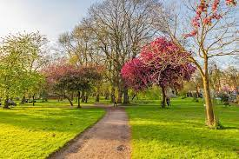
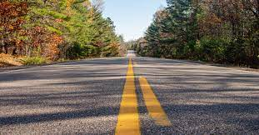
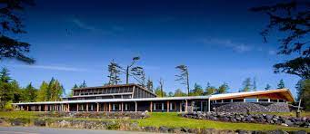
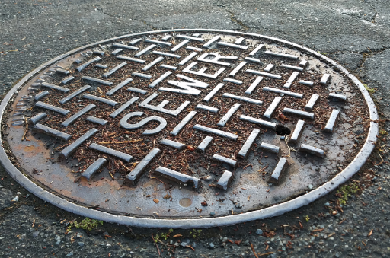
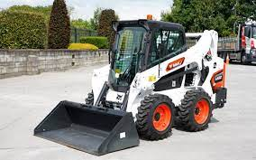
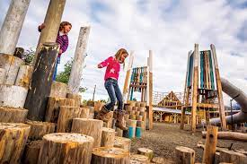
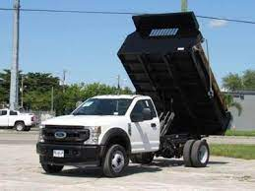
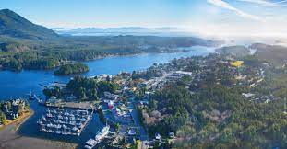

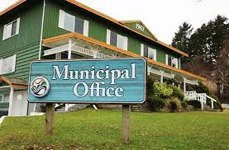
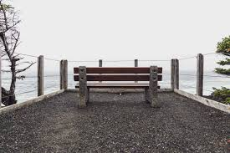
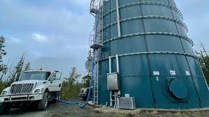
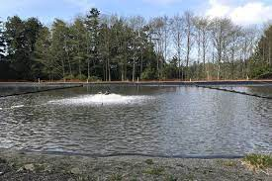
Capital works

Slide 18
2024 – 2028 Capital plan
Provides an overview of the five-year capital requirements as of December 2024 for all departments.
“Fund” indicates where the municipality should be funding the project from (reserves).
New reserve accounts were adopted in 2023. Transfers from the general reserve accounts will occur in 2024.
Funding of the new reserve accounts should be considered within the operational budget.
Projects are derived from directives from Council; Master Plans (sanitary, water, storm, parks & recreation; OCP); Infrastructure requirement and Development.
Projects may move within the Capital Plan based on approved funding, new grant opportunities and emergency operational requirements.
Projects can be advanced through long- and short-term borrowing.
Fund Legend
Affordable Housing | AF
Barkley Community Forest | BCF
Carry Forward from Previous Year | CFW
Covid Grant | COVID
Development Cost Charges | DCC
Donations | D
Emergency Services Reserves | ER
General Reserves | GR
Grants | G
Harbour Reserves | HR
In Progress | IP
Operations | Ops
Recreation Reserves | RR
Resort Municipality Imitative | RMI
Sewer Reserves | SR
Short Term Equipment Loan | STEL
Water Reserves | WR

Slide 19


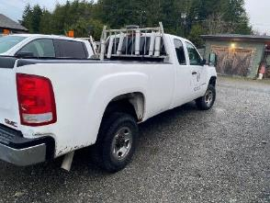
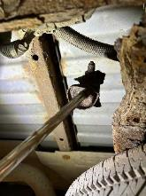
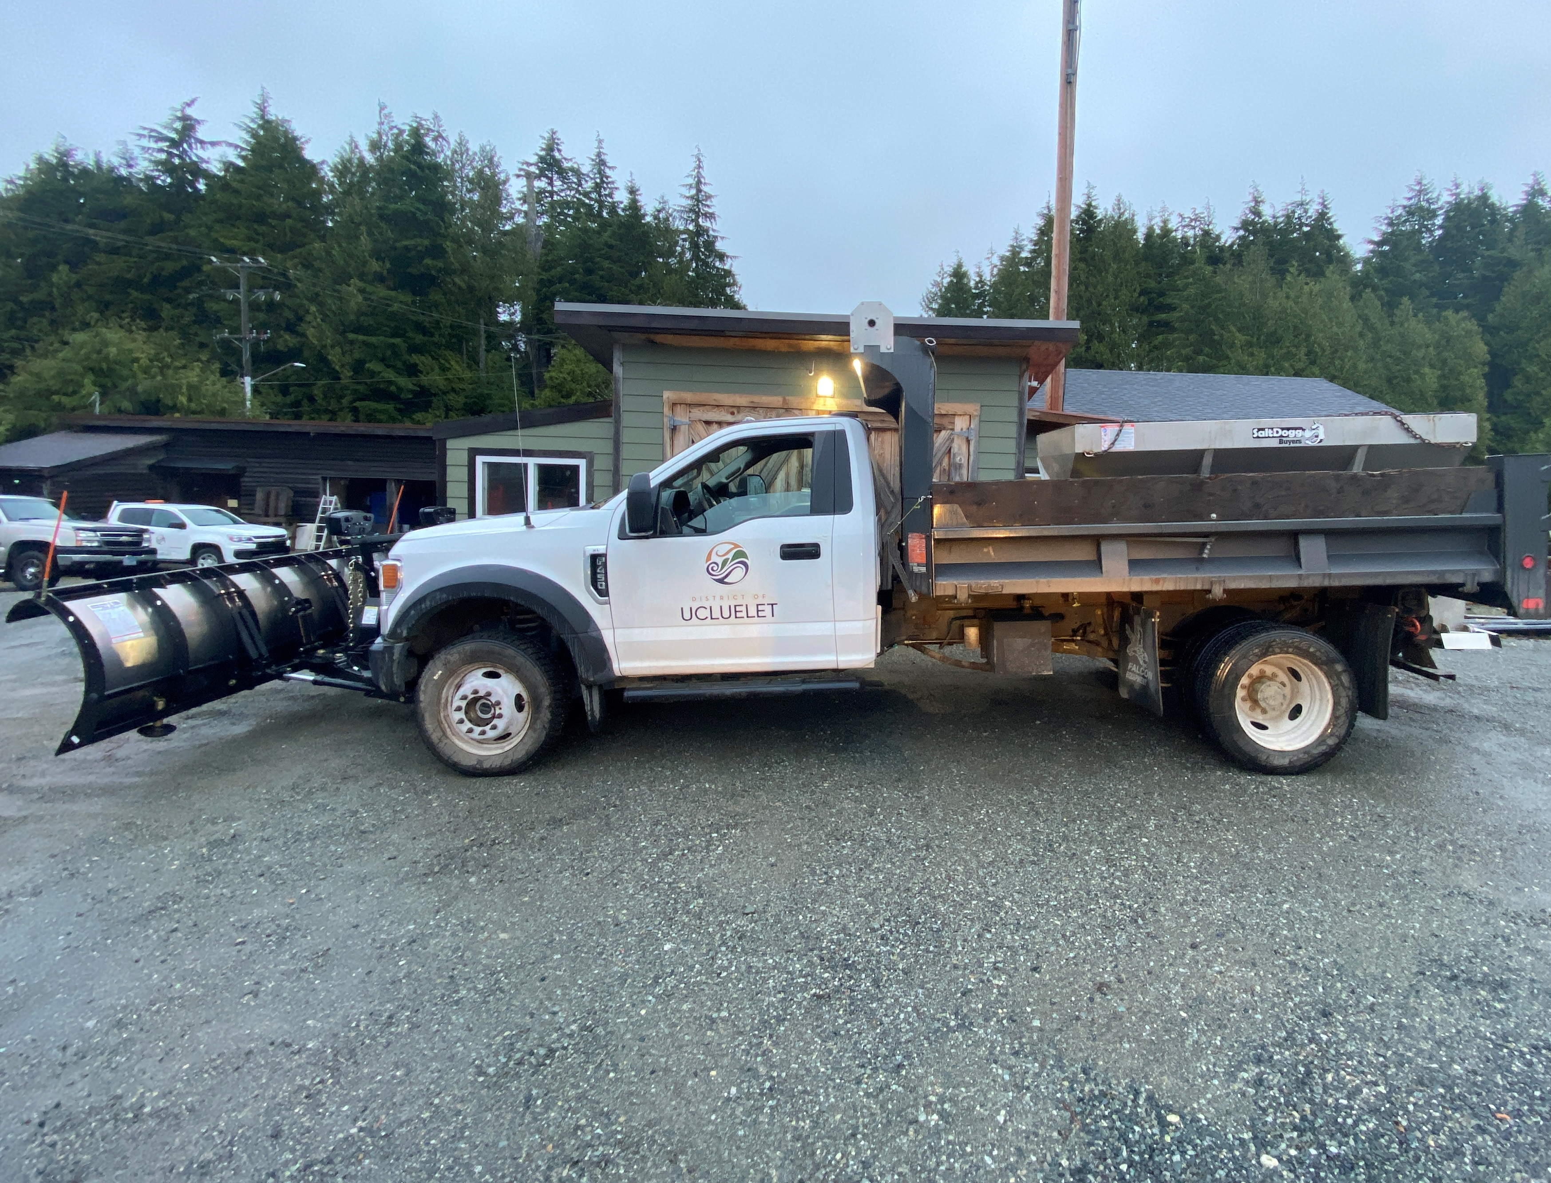
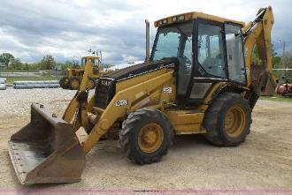
2008 ¾ Tonne
$80,000 - $100,000
Typical useful life is 10 – 15 years. Repair costs are escalating. Required for parks operations. Undercarriage is compromised.
3 Tonne Dump Truck
$100,000 - $120,000
Currently Operations only has one 3t Ford F450. Primary workhorse vehicle for parks and public works. Limits work effectiveness with only one vehicle with this capacity.
1998 Cat Backhoe
$200,000 - $250,000
Primary excavation machine for operations. Experiencing substantial down time and repair costs. Machine is well beyond useful life with exponentially increasing repair and maintenance costs.

Slide 20
Fleet
FLEET | Fund | 2024 | 2025 | 2026 | 2027 | 2028
1998 Cat Backhoe | STEL | 250,000
2007 Can-Am ATV | GR |  | 30,000
2008 Ford Ranger | GR |  |  |  |  | 40,000
2008 GMC Sierra | STEL | 100,000
2008 GMC Unit 2 | GR |  |  |  |  | 40,000
DUMP TRUCK (second) | STEL |  | 100,000
TOTAL |  | 350,000 | 130,000 | 0 | 0 | 80,000
Average age of municipal fleet is 12-years. With a 15-yr maximum life cycle. District has replaced a number of 15-20-yr old vehicles in recent years with the backhoe at 26 yrs. Staff will be considering both lease and purchase options.

Slide 21
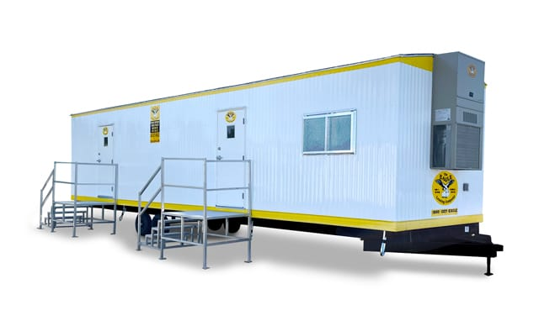
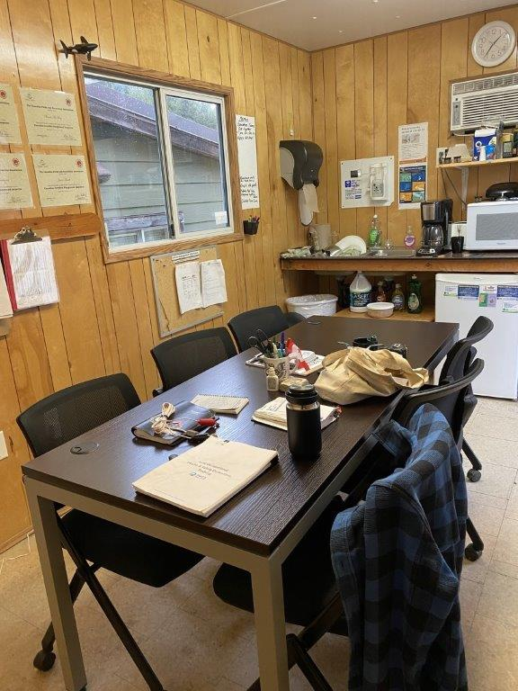
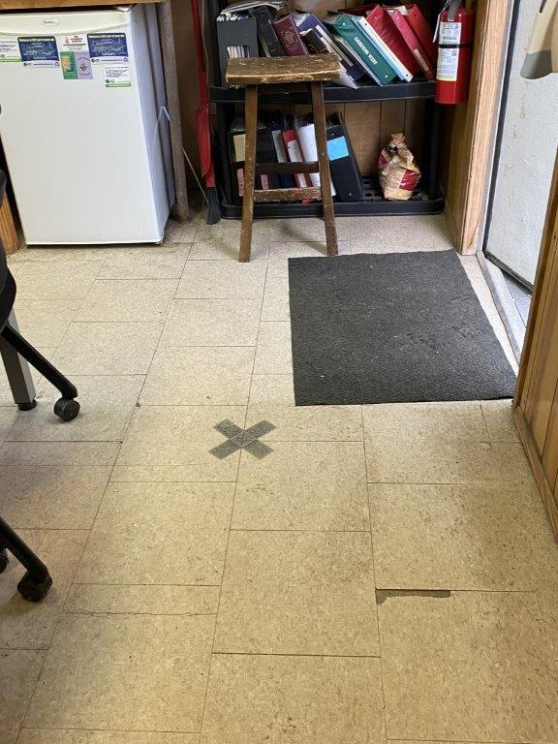
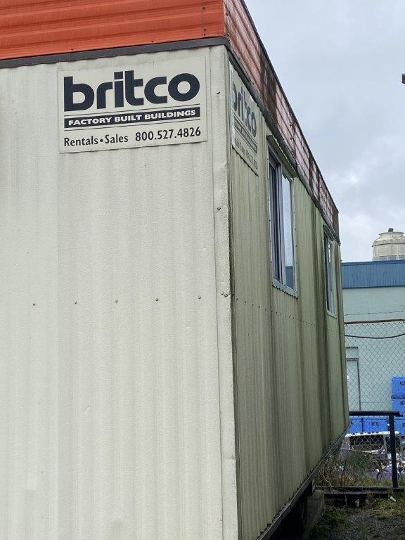
Parks & Operations Building
$75,000
Parks office is a 9.5 x 24’ trailer. Fits 2-3 people per manufacturer’s specifications with a parks crew of 6. Floor is rotting out.
New trailer proposed to be added to operations trailer increasing joint workspace and facilitate move to amalgamating parks and public works teams.
Notes:
Funding through remaining 2022 COVID restart grant.

Slide 22
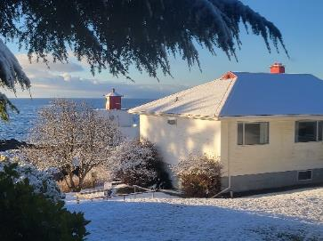
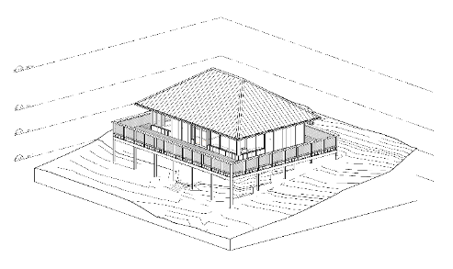
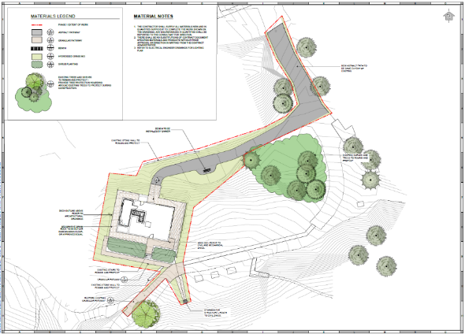
Amphitrite House
$1,692,000
$997,874 ICIP GRANT $594,126 RMI
$100,000 TVI
Redevelopment of the Lighthouse Keepers Residence at Amphitrite Point
Notes:
Tourism Vancouver Island Grant

Slide 23
Municipal buildings
BUILDINGS | Fund | 2024 | 2025 | 2026 | 2027 | 2028
Amphitrite House | G/RMI/GR | 912,682
Fleet Storage Shed | GR | 50,850
Lyche Building - exterior envelope | GR |  |  | 150,000
Lyche Building - community porch / stage | GR |  |  | 25,000
Equipment Furnishings UCC | GR |  |  | 44,000
Floor Refurnishing | GR |  | 40,000
UCC Capacitor/Generator | GR | 120,000
UCC Storage Addition | GR | 68,000
UCC Painting | RR |  | 20,000
UCC Heat Pumps | RR |  | 35,000
Rec Hall Replacement Plan | BCF | 75,000
Atco Trailer (Additional Office & Work Space) | GR | 75,000
REC Hall Replacement | G/BCF/RR |  |  |  |  | 3,000,000
TOTAL |  | 1,301,532 | 95,000 | 219,000 |  | 3,000,000
Notes:
UCC – AV removed – project completed
Lyche Building Improvements - $50k differed

Slide 24
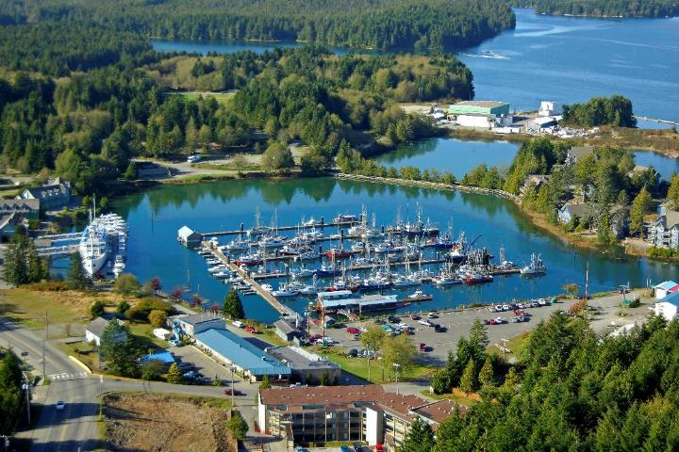
Inner Boat Basin Pathway
(Safe Harbour Pathway)
$735,000
$435,000 RMI
$300,000 HR
Harbour Path From Parking Lot to Waters Edge
Repair and Replacement of Waters Edge Walkway

Slide 25
Harbour
HARBOUR | Fund | 2024 | 2025 | 2026 | 2027 | 2028
Float Plane Upgrade at Whiskey Dock | HR | 30,000
Inner Harbour Walkway | HR/RMI | 132,002 | 600,000
Boat Launch Extension | HR | 80,000
TOTAL |  | 242,002 | 600,000 | 0 | 0 | 0
Harbour projects fully funded through harbour reserves.
Re-allocated Inner Harbour Walkway Funding to reflect anticipated expenditures
Notes:
Moved up boat Launch Extension
Re-allocated funding for harbour walkway to reflect actual spending years

Slide 26
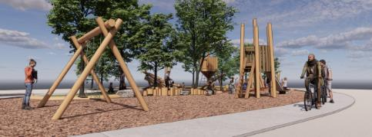
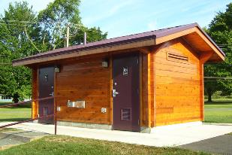
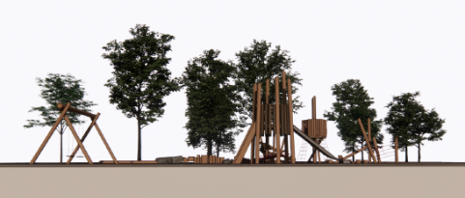
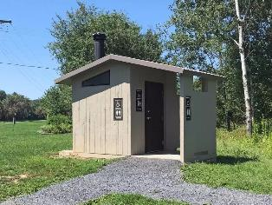
Village Green Playground
$349,000
RMI
Installation of a new playground within the Village Green park, fully funded through RMI.
Park Washrooms
$340,000
DDF
$150,000
RMI
Replacement of potable toilets with permanent washroom and deep well facilities. Reduces waste disposal costs.

Slide 27
Parks and trails
PARKS & RECREATION | Fund | 2024 | 2025 | 2026 | 2027 | 2028
Village Green Lighting & Elec. | GR |  |  |  | 100,000
DDF Washroom Project | G | 340,000
High Volume Pit Toilets | RMI | 150,000
WPT Bridge & Walkways Replacement | RMI/RR | 70,000
WPT – Coast guard RD - Relocate Trespassing section | RR |  | 40,000
WPT Marine Drive trailaheads | RR |  |  |  |  | 50,000
Pass of Melfort trail | RR | 40,000 | .
Marine Drive/Forbes Rd connector trial | RR |  |  |  | 40,000
Terrace Beach / Spring Cove midden trail | RR |  |  |  | 60,000
Spring Cove trail 2 | RR |  |  |  |  | 80,000
Edna Batchelor Park Playground | RR |  |  | 140,000
Village Green Playground | G | 217,547
Furnishings - green space (Garbage Cans & Benches) | RMI/RR |  |  |  |  | 80,000
Alder Park: Kayak Launch | CFW | 5,000
Skate Park Expansion | G/D/RR |  | 80,000 |  |  | 320,000
TOTAL |  | 822,547 | 120,000 | 140,000 | 200,000 | 530,000
Notes:
Added Skate Park Design work funded through recreation reserves; Added $320K for skate park build funded through grants.

Slide 28
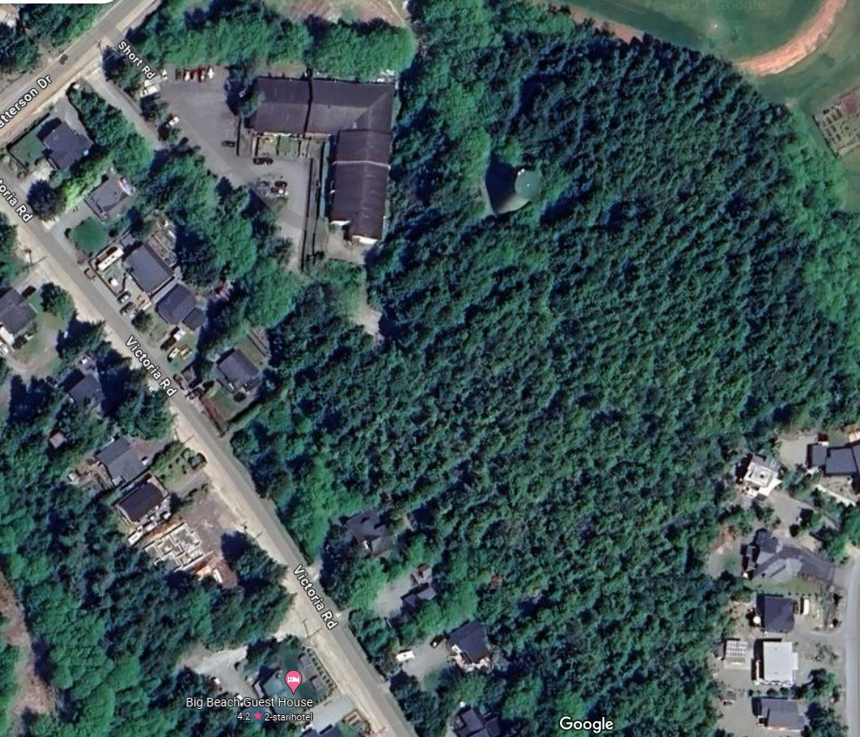
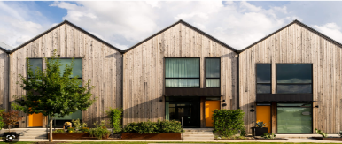
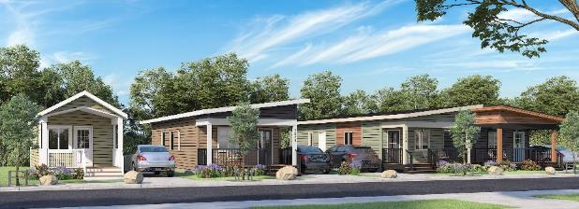
AFFORDABLE HOUSING
$175,000 AF
Grant funded Supportive Housing Development
1300 Peninsula Rd (5 units)
Lot 13 Affordable Housing
$650,000 AF
Funding allocation to support the development of
Lot 13 - 731 Marine Drive (33 units Affordable Housing)
Water Tower Lot
$200,000
(GR or AF Unfunded)
Investigative work to determine how and if the site could be developed for affordable housing.

Slide 29
Affordable housing
GENERAL | Fund | 2024 | 2025 | 2026 | 2027 | 2028
Water Tower Property Feasibility Study | GR |  | 200,000
Supportive Housing 1300 Peninsula Road | AF | 167,000
Lot 13 Affordable Housing Contribution | AF |  | 650,000
Capacity Building | AF | 75,000 | 75,000
TOTAL |  | 242,000 | 925,000 | 0 | 0 | 0
Affordable housing is currently funded through the OAP. Water tower property feasibility study is currently funded partly through the affordable housing reserve and general reserves. The study may be eligible to be funded through affordable housing but only if the site is designated for an affordable housing project.
Notes:
Moved Water Tower Property Feasibility Study to 2025 split between reserves and AF fund

Slide 30
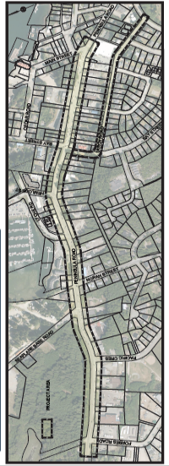
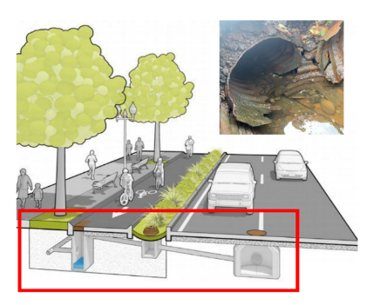
Peninsula Road Revitalization and Storm System Replacement
$3.23M
$1,000,000 Gas Tax
$140,000 RMI
$750,000 CCRF
$580,000 MOTI
$490,000 BC GCF
$270,000 GR
Stormwater system replacement, landscaping, bike lane, pedestrian path, parking and driveway access improvements.
*MOTI plans to repave the impacted area of Hwy 4 upon completion of the project.

Slide 31
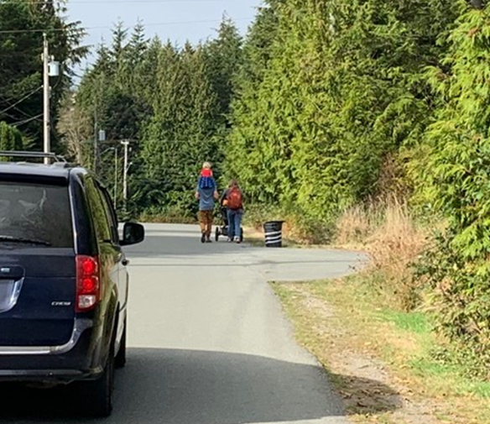
Larch Road Multi-Use Active Transportation Pathway
$662,500
$463,750 BCAT
$198,750 GR
Development of an accessible and age-friendly Multi-Use Path between Bay St. to Matterson Rd.

Slide 32
roads
ROADS | Fund | 2024 | 2025 | 2026 | 2027 | 2028
Peninsula Road Safety and Revitalization | G/GR | 1,429,527
Storm System Engineering and Replacement | G/GR | 1,244,300
Peninsula Road boulevard upgrades | G |  |  |  | 300,000
Matterson Bike Lane Painting | G |  |  |  | 50,000
Road Resurfacing | GR |  |  |  | 300,000
Larch Road Safety and Revitalization | G/GR | 656,700
TOTAL |  | 3,330,527 |  |  | 650,000

Slide 33
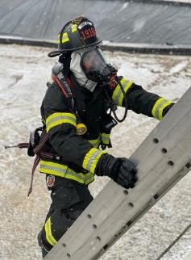
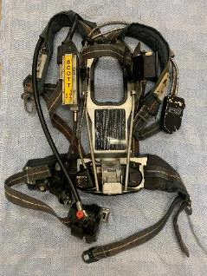
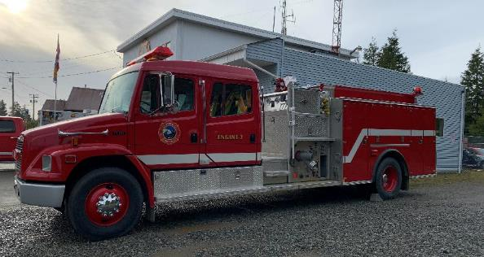
SCBA’s (PRE 1992)
$200,000 (ER)
Replacement of existing Self-Contained Breathing Apparatus
Turnout Gear
$28,964 G
Purchase of new turn out gear for members, retiring old gear to backup.
Engine 2 Replacement
$800,000 STEL
Replacement of the 23-yr old primary response vehicle.

Slide 34
Emergency services
EMERGENCY SERVICES | Fund | 2024 | 2025 | 2026 | 2027 | 2028
Tsunami Sirens - lighthouse | G |  | 30,000
Tsunami Sirens - Cedar | G | 30,000
Turnout Gear | G | 28,964
SCBA | ER | 200,000
Engine 2 Replacement | STEL |  | 800,000
Mini Pumper (Rescue 1 Replacement) | ER |  |  | 600,000
Fire Hall Replacement | ER |  |  |  | 6,600,000
Exterior Stairs Replacement | ER | 23,500
Fire Hall Development Plan | ER | 100,000
Fire Hall Heat Pump | ER | 15,000
TOTAL |  | 397,464 | 830,000 | 600,000 | 6,600,000 | 0
Notes:
Tsunami kiosks – completed in 20023
Mini pumper increased to $600K -

Slide 35
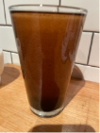
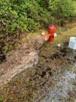
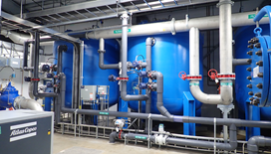

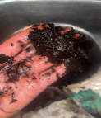
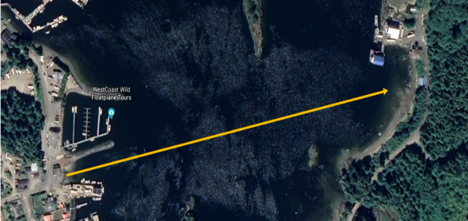
Water Treatment System
$9.6M
$7,039,680 ICIP
$2,560,300 DoU GR
Development of a water filtration system to remove high levels of manganese and iron which significantly impact water quality.
Water Service Line
$1,300,000
$652,000 Disaster Assistance Fund (EMCR)
$448,000 DoU – BC GCF
Design and install replacement water supply submarine line in the inlet connecting Mercantile Creek to Bay Street Pump House. RFP results came in substantially higher than anticipated at $1.3M up from $1M

Slide 36
Water Capital summary
 | 2024 | 2025 | 2026 | 2027 | 2028
Provincial Grants | 1,300,000 | 45,000
Federal Grants | 381,600 | 3,329,040 | 3,329,040
Reserves | 218,400 | 1,170,950 | 1,220,950
Operating Funds | 14,919 |  |  | 2,500,000
Total Revenue | 1,914,919 | 4,544,990 | 4,549,990 | 2,500,000
Water Capital Projects | 1,914,919 | 4,744,990 | 4,549,990 | 2,500,000
Total Expenditures | 1,914,919 | 4,744,990 | 4,549,990 | 2,500,000 | 0

Slide 37
Sanitary Capital summary
 | 2024 | 2025 | 2026 | 2027 | 2028
Provincial Grants | 57,550
Federal Grants | 240,000 | 960,000 | 510,000 | 425,000
Reserves | 156,000
Debt |  | 1,250,000 | 1,462,143 | 2,832,143 | 565,2143
Total | 453,550 | 2,210,000 | 1,972,143 | 3,257,143 | 565,2143
Sanitary Capital Projects | 453,550 | 2,210,000 | 1,972,143 | 3,257,143 | 5,652,143
Total Expenditures | 453,550 | 2,210,000 | 1,972,143 | 3,257,143 | 5,652,143

Slide 38
Capital revenue and expenditures distribution - 2024

Slide 39
Capital Summary
 | 2024 | 2025 | 2026 | 2027 | 2028
Provincial Grants | 5,233,656 | 425,000 |  | 550,000 | 450,000
Federal Grants | 2,288,872 | 4,339,040 | 3,839,040 | 425,000
Transfers from Own Reserves | 1,342,558 | 2,485,950 | 1,404,950 | 300,000 | 3,080,000
Operating Funds | 378,504 |  | 175,000 | 2,500,000
Debt Funding | 350,000 | 2,180,000 | 2,062,143 | 9,432,143 | 5,732,143
Total Revenue | 9,593,590 | 9,429,990 | 7,481,133 | 13,207,143 | 9,262,143
Affordable Housing | 167,000 | 650,000
Buildings | 125,085 |  | 175,000 | 6,700,000
General Gov't | 252,947 | 250,000
Emergency Services | 397,464 | 900,000 | 600,000
Fleet | 350,000 | 30,000 |  |  | 80,000
Parks & Recreation | 2,242,296 | 245,000 | 184,000 | 60,000 | 3,530,000
Roads | 3,448,327 |  |  | 690,000
Sanitary | 453,550 | 2,210,000 | 1,972,143 | 3,257,143 | 5,652,143
Water | 1,914,919 | 4,544,990 | 4,549,990 | 2,500,000
Harbour | 242,002 | 600,000
Total Expenses | 9,593,590 | 9,429,990 | 7,481,133 | 13,207,143 | 9,262,143

Slide 40
Capital project funding process
Evaluation of capital needs
(5 & 20 year capital plan)
Funding within operational budget of depreciating assets (i.e. fleet)
Dedicated contingency funding within operational cost centers
Contingency funds transferred to reserves at end of fiscal year
Combination of Reserves, borrowing, grants, etc. fund capital projects

Slide 41
Borrowing - Current
 | Year Received | Original Amount | Final Payment | Interest Rate | Current Payment | Total Remaining
Equipment Loan (Vehicles) | 2022 | $350,000 | 2027 | 5.61% | $60,386 | $266,267
Equipment Loan (Vehicles) | 2020 | $200,000 | 2025 | 5.61% | $38,941 | $64,450
Fire Truck | 2017 | $475,000 | 2032 | 2.80% | $38,839 | $279,307
Ucluelet Community Centre | 2011 | $1,948,000 | 2036 | 1.47% | $80,830 | $1,200,000
Totals |  | $2,973,000 |  |  | $218,996 | $1,810,024
Notes:
In 2021 DoU Debt Servicing Limit was $1.5M
Debt Servicing is the equivalent to total allowable payments at current interest rates $1.5 minus $218K = $1,282,000 of available servicing fees

Slide 42
Debt Funded Projects
Debt funded projects can be deferred although They are all high priorities that need to be funded. Staff will work on grant offset options as they become available.
Increases in capital requisitions starting in 2024 will reduce but not eliminate the need to borrow in the future.
Borrowing amounts as presented do no include interest which will require increased tax requisitions to cover the principal and interest payments.
Project | 2024 | 2025 | 2026 | 2027 | 2028
Excavator Replacement | 250,000
3/4 Tone Replacement | 100,000
Dump Truck |  | 100,000
ATV Replacement |  | 30,000
Engine 2 Replacement |  | 800,000
Hemlock Lift Station |  | 1,250,000
Mini Pumper |  |  | 600,000
Gravity Main Replacement |  |  | 357,143
Peninsula Rd at Seaplane Base Rd |  |  | 50,000
Upgrading of 100 mm and 150 mm Dia. Mains |  |  | 620,000
Emergency Power Generator |  |  | 180,000
Sludge Removal |  |  | 275,000
Fire Hall Replacement |  |  |  | 6,600,000
Gravity Sewer Main Replacement (other areas) |  |  |  | 357,143
Peninsula Rd, 1860 Pen Rd to 1816 Pen Rd |  |  |  | 175,000
Upgrading of 100 mm and 150 mm Dia. Mains |  |  |  | 620,000
Electrical/Controls Kiosk Replacement |  |  |  | 420,000
Emergency Power Generator |  |  |  | 160,000
Force main Discharge Grit Removal Chamber |  |  |  | 1,100,000
Bay St Area Sewer Main Replacement |  |  |  |  | 2,500,000
Gravity Sewer Main Replacement (other areas) |  |  |  |  | 357,143
Hemlock St, Lyche Rd to Existing Lift Station |  |  |  |  | 220,000
Bay St, Peninsula Rd to 1800 Bay St |  |  |  |  | 75,000
Upgrading of 100 mm and 150 mm Dia. Mains |  |  |  |  | 620,000
Electrical/Controls Kiosk Replacement |  |  |  |  | 420,000
Emergency Power Generator |  |  |  |  | 160,000
Routing Options |  |  |  |  | 200,000
Septage Receiving Station |  |  |  |  | 1,100,000
TOTAL | 350,000 | 2,180,000 | 2,082,143 | 9,432,143 | 5,652,143

Slide 43
FUNDING BY SOURCE AND YEAR
Year
2024-25-26-27-28
2024-25-26-27-28
2024-25-26-27-28
2024-25-26-27-28
2024-25-26-27-28
Notes:
$2.5M in 2027 from operating are DCC funds for new water tower.

Slide 44
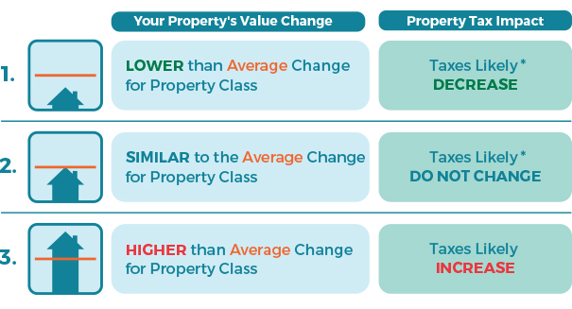
Property taxes
2024 assessments are based on July 1, 2023 market values
Average increase for a Single Family home in Ucluelet is -1.5%
Average increase for business is 12% (recovered to pre-COVID values – 2020 assessments)
Does not automatically translate into a corresponding increase in property taxes
Notes:
Only looking at the municipal tax requisition. District will be advised on the ACRD, Hospital, Police, BC Assessment ,School and Library in due course. Staff have requested the ACRD present their budget to Council at the March 12 regular meeting and have invited them to join us at our budget open house on March 14.

Slide 45
% change in residential Assessed value
% Change | Total Properties
0 to -14% | 994
0 to 12% | 371
13 - 25 % | 17
25 to 50%+ | 46
Notes:
Important to note this when looking at overall impacts on induvial property tax bills.

Slide 46
% change in Business Assessed value
% Change | Total Properties
0 to -9% | 20
0 to 5 % | 89
6 to 23% | 84
40 to 55%+ | 18
Notes:
Note adjustment with increase in overall assed value, means increased impact on tax requisition on individual properties

Slide 47
Average assessed values for 2024 Completed Roll
Class 1 | 2024 Count | 2024 | 2023 | 2022
Vacant | 183 | 146,221,800 | 148,779,400 | 129,971,700
Single Family | 800 (815 in 2023) | 694,752,900 | 730,112,400 | 594,651,900
Strata/Other | 479 (451 in 2023) | 268,131,700 | 243,788,600 | 203,981,700
Total Residential | 1,462 | 1,128,958,700 | 1,122,680,400 | 928,605,300
Other Classes | Count | 2024 | 2023 | 2022
Utilities | 8 | 661,600 | 607,200 | 550,200
Light Industrial | 3 | 571,000 | 555,000 | 549,200
Business | 399 (401 in 2023) | 184,301,443 | 162,300,902 | 126,209,502
Recreation | 35 | 6,258,100 | 5,648,900 | 4,266,900
TOTAL OTHER | 445 | 1,409,471,655 | 1,291,792,402 | 1,060,181,102

Slide 48
Non-market Changes
Changes in Inventory – i.e. new construction, renovations etc.
Additions or Deletions – adding subdivisions, merging properties
Property Class Changes – Business to Residential or Residential to Business
Zoning Changes – Changes in property zoning/land use designation
Property Type | Total Non-Market Changes | Additional Property Taxes
Residential | $23,653,000 | $57,294
Business | $4,348,100 | $37,916
Notes:
New tax dollars within the assessment.

Slide 49
Indicative Tax Rate Increases - 2024
 | Indicative Range | Indicative Average
Island municipalities | 3.5% - 9.7% | 7.3%
Campbell River, Comox, Courtenay, Cumberland, Nanaimo
RMI municipalities | 5% - 9% | 6.9%
Invermere, Revelstoke, Rossland, Ucluelet, Resort Municipality of Whistler

Slide 50
2024 Tax Requisition Change Summary
Item | Requisition | % Increase Residential | % Increase Business |  | Requisition | % Increase Residential | % Increase Business
Operational Requisition | $477,850 | 5.09% | 5.05% |  | $477,850 | 5.09% | 5.05%
Water Filtration Project | $150,000 | 1.77% | 0.995% |  | $250,000 | 2.829% | 1.589%
Capital Investments | $150,000 | 1.77% | 0.995% |  | $250,000 | 2.829% | 1.589%
TOTAL | $777,850 | 8.63% | 7.04% |  | $977,850 | 10.748% | 8.229%
Council reviewed the above options and is contemplating an additional tax increase to fund essential water and capital investments; shown within Option A on slide 52.
Council is inviting community input on increasing the dedicated capital investments and corresponding tax increase needed to address the current capital infrastructure deficit and borrowing requirements shown on slide 42.
Notes:
Budget based on an annual $300,000 dedicated additional requisition to capital program.
300 in 2024, 300 in 2025 etc.
Impact of adding $300 annual is reduced each year due to increased total assessments and non-market changes.

Slide 51
Updated 2024 Capital Requisition
Council is contemplating OPTION A with a maximum requisition of $750,000 dedicated to general capital, $250,000 dedicated to the water filtration project and maintaining the operational requisition at $477,850. General capital investments are dedicated to the repair and replacement of existing water, sanitary, roads, storm infrastructure and equipment.
The dedicated water requisition will be used to reduce the need to borrow funds for the planned water treatment project occurring in 2025/26.
Dedicated capital contributions will reduce the need to borrow funds for essential capital repairs and infrastructure replacement as shown on slide 42. Reduced borrowing requirements will save the community significant interest payments that would be incurred if borrowing were the primary source of capital investment funding.

Slide 52
2024 Tax Requisition Change Summary
Updated
 | OPTION B |  |  |  | OPTION A
Item. | Requisition | % Increase Residential | % Increase Business |  | Requisition | % Increase Residential | % Increase Business
Operational Requisition | $477,850 | 5.09% | 5.05% |  | $477,850 | 5.09% | 5.05%
Water Filtration Project | $250,000 | 2.69% | 1.51% |  | $250,000 | 2.57% | 1.45%
Capital Investments | $500,000 | 5.39% | 3.03% |  | $750,000 | 7.71% | 4.34%
TOTAL | $1,227,850 | 13.17% | 9.59% |  | $1,477,850 | 15.37% | 10.83%
Tax rate implications related to option A are shown on the following slides.
Notes:
Budget based on an annual $300,000 dedicated additional requisition to capital program.
300 in 2024, 300 in 2025 etc.
Impact of adding $300 annual is reduced each year due to increased total assessments and non-market changes.

Slide 53
(OPTION A) average 2024 Potential property tax implications by class and average assessed value based on 15.73% Residential Rate
Class | Average 2023 Assessment | Average 2024 Assessment | % Change | Toral 2023 Property Tax Levy | Total 2024 Property Tax Levy | $ Change
1 – Residential | $774,796 | $772,201 | -0.33% | $1,744 | $2,343 | $600
2 – Utilities | $75,900 | $82,700 | 8.96% | $384 | $2,259 | $1,875
5 - Light Industrial | $185,000 | $190,333 | 2.88% | $2,204 | $3,058 | $854
6 – Business | $404,740 | $461,908 | 14.12% | $3,568 | $5,046 | $1,478
8 – Recreational | $161,397 | $178,802 | 10.78% | $1,415 | $2,113 | $699
Notes:
Utilities is increasing significantly due to undercharging them in previous year. Utilities includes TELUS, BC Hydro etc. Maximum allowable is 2.6 times the business class rate or $40 per $1000 of assessed value.

Slide 54


Potential Residential Property Tax Impacts – single family homes
Assessed Value 2023 | Assessed Value 2024 | % Change | Municipal Tax 2023 | Municipal Tax 2024 | $ Change
$973,000 | $842,000 | -13.46% | $2,190 | $2,555 | $365
$885,000 | $819,000 | -7.46% | $1,991 | $2,485 | $494
$878,000 | $878,000 | 0.00% | $1,976 | $2,664 | $688
$825,000 | $879,000 | 6.55% | $1,856 | $2,667 | $811
$892,000 | $1,032,000 | 15.70% | $2,007 | $3,131 | $1,124
$836,000 | $1,164,000 | 39.23% | $1,881 | $3,532 | $1,651
Large increases in assessed value are generally due to improvements to the land or property,
adding an ADU, new home construction, construction of a STR to a home.

Slide 55
Potential Property Tax Impact other home types
 | Assessed Value 2023 | Assessed Value 2024 | % Change | Municipal Tax 2023 | Municipal Tax 2024 | $ Change
Manufactured Home | $65,700 | $117,000 | 78.08% | $148 | $355 | $207
Manufactured Home | $260,000 | $251,000 | -3.46% | $585 | $762 | $177
Duplex Home | $398,000 | $468,000 | 17.59% | $896 | $1,420 | $524
Land | $443,000 | $874,000 | 97.29% | $997 | $2,652 | $1,655
Notes:
Reminder that home owner grants remove $770 for primary residents for all properties under the age of 65 yrs. Over 65 yrs. $1065 reduction.

Slide 56
Potential Business
Property Tax Impacts
Assessed Value 2023 | Assessed Value 2024 | % Change | Municipal Tax 2023 | Municipal Tax 2024 | $ Change
$866,000 | $805,000 | -7.04% | $7,633 | $8,794 | $1,160
$897,000 | $897,000 | 0.00% | $7,907 | $9,799 | $1,892
$876,000 | $960,000 | 9.59% | $7,722 | $10,487 | $2,765
$819,900 | $960,900 | 17.20% | $7,227 | $10,497 | $3,270
$829,400 | $1,228,000 | 48.06% | $7,311 | $13,414 | $6,104
$986,000 | $2,326,000 | 135.90% | $8,691 | $25,409 | $16,718
Business property values increased by and average of 12% in 2023 returning to pre-COVID values (2020)

Slide 57
Potential Split class & Business
Property Tax Impacts
 | Assessed Value 2023 | Assessed Value 2024 | % Change | Municipal Tax 2023 | Municipal Tax 2024 | $ Change
Restaurant | $416,000 | $427,900 | 2.86% | $3,667 | $4,674 | $1,007
General Business | $540,000 | $756,000 | 40.00% | $4,760 | $8,258 | $3,499
Bed and Breakfast | $1,138,000 | $999,000 | -12.21% | $10,031 | $10,913 | $882
Single Family with Short Term Rental | $224,000 | $215,100 | -3.97% | $504 | $653 | $149
 | $629,000 | $765,000 | 21.62% | $5,544 | $8,357 | $2,812
Single Family with Short Term Rental | $778,100 | $762,000 | -2.07% | $1,751 | $2,312 | $561
 | $2,126,000 | $2,026,000 | -4.70% | $18,740 | $22,132 | $3,392
Single Family with Short Term Rental | $169,500 | $143,600 | -15.28% | $381 | $436 | $54
 | $164,300 | $176,200 | 7.24% | $1,448 | $1,925 | $477

Slide 58
Next steps
Revise Operations and Capital Budget as directed by Council (January)
Confirm dedication of reserve funding by Council (January)
Finalize year end expenditures and revenues (January)
Finalize transfers to and from reserves based on 2023 budget (January)
Confirm funding of Capital projects through reserves and new tax requisitions (January)
Update BC Assessment Role and Confirm tax implications (January)
Present updated budget with validated tax implications for Council’s consideration (February))
Amend budget (if required) and present to public for comments. (March)
Provide public comments to Council with updated BC Assessment role implications. (April/May)
Prepare Bylaws for Adoption (May)

